Slide 1
GLOBAL OIL PRICES
& Geopolitical Events Pipeline
Advanced Professional Certificate in Data Science & Artificial Intelligence
Module 2 Project | DSAI-4 |Group- 8
Team Members
Daniel Chan Chee Seng
Edwin Yap Wei Tian
Julius Tiew
Jagatheeswaran Rajagurunathan
Bhupinder Kaur
From Raw CSV to Business Insight — Powered by DuckDB, Meltano, BigQuery, dbt & Dagster

Slide 2
Executive Summary
Problem Statement: A curated timeline of major geopolitical events affecting global oil markets, including wars, sanctions, supply disruptions, and OPEC policy decisions.
Background
The global oil market is highly sensitive to geopolitical events, macroeconomic shifts, and market sentiment. Understanding how these factors interact with oil price movements is critical for energy analysts, policymakers, and investors.
However, the relationship between geopolitical risk, financial market volatility, and oil prices is complex, non-linear, and varies across different market regimes.
Overview
This dataset explores the relationship between global oil markets and geopolitical events from 2010 to 2026. It combines daily oil price data with macroeconomic indicators, a geopolitical risk index, and a curated timeline of major global events that have historically influenced energy markets.
Brent Crude (Global Benchmark): Often referred to as European/North Sea crude, this is used to price roughly two-thirds of the world's traded oil. It is primarily refined in Northwest Europe and is sensitive to political tensions in Europe, Africa, and the Middle East.
WTI Crude (US Benchmark): Referred to as US Crude or Light Sweet Crude, this is primarily used for gasoline production in the United States. It is transported via pipeline from locations like Cushing, Oklahoma, and is highly sensitive to US production data.

Slide 3
Data Overview
Data Sources:
oil_geopolitics_dataset_2010_2026.csv – Final merged dataset with engineered features and event annotations
geopolitical_events_timeline.csv – Timeline of major geopolitical events affecting global oil markets
In addition to raw financial data, the dataset includes engineered features such as lagged prices, rolling volatility measures, and price spreads between Brent and WTI. A curated list of major geopolitical events—including wars, sanctions, supply disruptions, and OPEC policy changes—is also included, allowing researchers to analyze how geopolitical shocks affect oil markets.
Macroeconomic and geopolitical indicators, along with engineered financial features, provide a comprehensive framework for assessing market volatility and risk.
Data Contents:
Market Data
Brent crude oil price
WTI crude oil price
Macroeconomic Indicators
U.S. Dollar Index (DXY)
VIX volatility index
Geopolitical Indicators
Geopolitical Risk Index (GPR)
Engineered Features
Daily returns
Lagged prices
Rolling volatility measures
Brent–WTI spread
Event Annotations
Event flag (indicating major geopolitical events)
Event type
Event description
Event severity score

Slide 4
Data Design
Data Model Design
┌─────────────────────────────────────────────────┐
MART LAYER
mart_oil_geopolitics
JOIN two staging tables
(LEFT JOIN stg_oil_prices + stg_geo_events)
4,047 rows — one row per trading day
└────────────────┬────────────────────────────────┘
built from
┌───────────—┴───────────┐
▼ ▼
┌─────────────┐ ┌──────────────────┐
STAGING LAYER STAGING LAYER
stg_oil_prices stg_geo_events
4,047 rows 35 rows
cast + clean cast + clean
└──────┬──────┘ └────────┬─────────┘
│ │
▼ ▼
┌─────────────┐ ┌──────────────────┐
RAW LAYER RAW LAYER
raw_oil_prices raw_geo_events
(as loaded) (as loaded)
└─────────────┘ └──────────────────┘
-- Cast date string → DATE type cast(date as date) as date
-- Cast price strings → FLOAT64 cast(brent_price as float64) as brent_price
-- Filter out nulls where date is not null

Slide 5
Solution Architecture
CSV Files
DuckDB
Meltano
BigQuery
dbt
Kaggle Dataset
Local Staging
& Validation
Extract & Load
tap-duckdb → target-bq
Data Warehouse
raw + dw schemas
Transform
Schema + Tests
(local SQL engine)
(Singer JSON messages)
Dagster Orchestration — schedules, monitors, and logs all pipeline stages
Jupyter
Reporting and Analysis

Slide 6
Technical Stack
Staging
CSV Files
Raw oil prices + geopolitical events
Source
Local ingestion data warehouse, validation before cloud, ensured data quality before cloud transfer and cost.
Ingested both CSVs into a lightweight local database for fast querying before cloud load.
Staging
DuckDB- >=1.1.0
Extract/Load
Meltano 4.1.2
EL — tap-csv → target-bigquery
Extractor: tap-csv (meltanolabs) 1.2.0; Singer tap — reads CSV as streams
Loader: target-bigquery (z3z1ma)- Singer target — writes to BigQuery
Could warehouse → Google BigQuery- Central analytical data store
Stored raw tables (raw_oil_prices, raw_geo_events) and served as the central data store
Cloud data warehouse. provided scalable storage for cross-table analysis.
Serverless, auto-scaling, pay-per-query; native dbt & Dagster integrations. Stored raw tables (raw_oil_prices, raw_geo_events) and served as the central data store.
Warehouse
BigQuery
9 / 12

Slide 7
Technical Stack
dbt-bigquery-> SQL-based staging + mart models
Data transformation: built-in testing, docs, and lineage DAGs.
Enforced data consistency and created the analytical joinCreated cleaned staging views and a joined mart table (mart_oil_geopolitics) combining oil prices with geopolitical events by date that unlocked findings 1, 3, and 4.
Transform
dbt 1.11.7
Orchestration. Ran the full pipeline end-to-end as a DAG — Meltano EL first, then dbt transformations, with visual asset tracking
Software-defined assets; visual DAG UI; native dbt + Meltano integrations; schedules + sensors
Orchestration
Dagster 1.12.19
Analysis
Jupyter 4.5.6
Jupyter for deep EDA; Power BI for executive dashboards and self-serve analytics
Environment
WSL ubuntu+ Conda
Python 3.11 Isolated Linux env on Windows ARM64
Auth
GCP ADC
Application Default Credentials
Language
Python
Application Default Credentials
9 / 12

Slide 8
Architectural Design
1: DuckDB as Local Staging Layer
DuckDB before BigQuerY
Validate data quality locally before paying for BigQuery compute
Fast columnar queries on CSV without a running database server
Zero-config — single file database
Acts as a fallback if cloud is unavailable
2. Meltano for Extract & Load :
2.1 Extract: Meltano 4.1.2 with tap-csv + target-bigquery
Declarative config in meltano.yml — reproducible and version-controllable
Singer protocol ensures compatibility between any tap and target
Handles incremental state, retries, and logging out of the box
Separates EL from transformation (EL tool should not transform data)
Raw Layer — No Transformations at Load Time
2.2 Load data exactly as-is into BigQuery raw tables- Raw → Staging → Mart
Preserves original data — always possible to re-transform from raw
Separates concerns — EL tool does not transform, dbt does
Easier debugging — if mart is wrong, raw data is unchanged

Slide 9
Architectural Design
3. dbt for Transformations: dbt-bigquery with staging + mart layers
SQL-based — easy to audit, version control, and test
Built-in data quality tests (not_null, unique, accepted_values)
Dependency graph — dbt knows staging must run before mart
Creates views in BigQuery — no data duplication, always fresh
Models designed:
raw_oil_prices → stg_oil_prices ─┐
├→ mart_oil_geopolitics
raw_geo_events → stg_geo_events ─┘
4. : Dagster for Orchestration: Dagster with 3 software-defined assets
Asset-based model — each step is a testable, observable unit
Visual UI at localhost:3000 — easy to monitor and re-run
Dependency enforcement — dbt_tests cannot run before dbt_transformations
Better than Airflow for small local pipelines — no separate DB required
Order: meltano_extract_load → dbt_transformations → dbt_tests

Slide 10
Architectural Design
5. Google cloud: Central analytical data store
ADC Instead of Service Account JSON Key
Application Default Credentials (gcloud auth application-default login)
Organisation policy blocked JSON key creation
ADC uses the logged-in Google account — same permissions
More secure — no key file to accidentally commit to git
Limitation: Cannot be used in fully automated production pipelines (requires interactive login periodically)
6: WSL Ubuntu for Pipeline Runtime
All Meltano/dbt/Dagster commands run in WSL, not Windows
Meltano has no Windows-native support — requires Linux shell
Python package builds (pendulum, grpcio) fail on Windows ARM64
WSL provides stable Linux environment without a separate VM
7. Python 3.11 via Conda
Conda environment meltano-env with Python 3.11
Python 3.13 (default on machine) caused pendulum==2.1.2 build failure
Conda allows isolated, reproducible environment separate from system Python
Python 3.11 is the last version with broad package compatibility for Meltano dependencies

Slide 11
Architecture view Summary
CSV Files
↓ (file read — no API)
DuckDB (local SQL engine)
↓ (Singer JSON messages via Unix pipe)
Meltano tap-csv
↓ (Singer JSON messages)
Meltano target-bigquery → (BigQuery Storage Write API via gRPC + ADC)
BigQuery raw tables
↓ (BigQuery Jobs API via REST + ADC)
dbt models (SQL views)
↓ (Python subprocess API)
Dagster assets
↓ (BigQuery REST API + ADC)
Jupyter / pandas DataFrame
↓ (BigQuery REST API + ADC)
Power BI dashboard
→
Notes:
# Correlation heatmap
cols = ['brent_price', 'wti_price', 'dxy_index', 'vix', 'gpr_index', 'brent_return', 'wti_return']
fig, ax = plt.subplots(figsize=(9, 7))
sns.heatmap(df[cols].corr(), annot=True, fmt='.2f', cmap='coolwarm', ax=ax)
ax.set_title('Correlation Matrix')
plt.tight_layout()
plt.show()

Slide 12
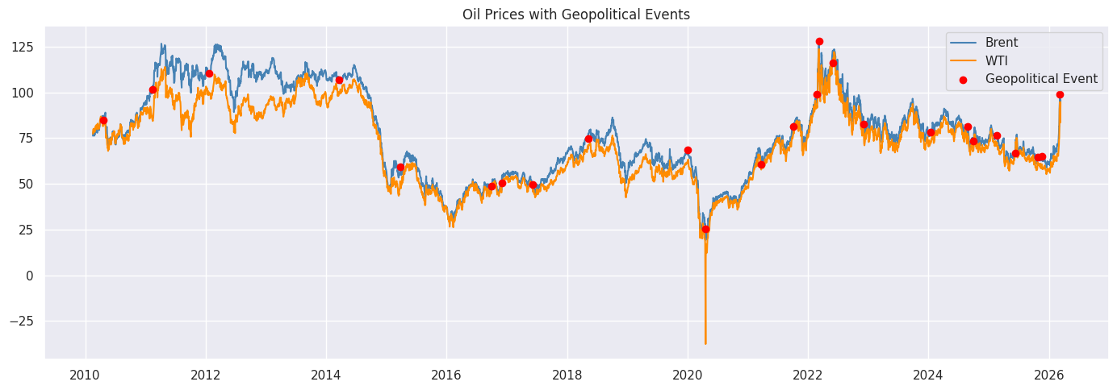
Data Analysis & Findings
Finding 1: Oil Prices Are Highly Volatile and Event-Driven
Brent crude ranged from approximately $20 to $130 per barrel over the period, with three major collapse-and-recovery cycles:
Period : Apr-2010 – Mar 2026 ; Oil price records : 4,047 daily observations; Geopolitical events : 35 tagged events
Key variables : Brent, WTI, DXY, VIX, GPR Index, returns, volatility
Summary:
2014–2016: OPEC supply glut + US shale boom- Brent fell ~70% from $115 to $30
2020: COVID-19 demand collapse + Russia-Saudi price war- WTI briefly went negative; Brent fell to ~$20
2022: Russia-Ukraine war- Brent spiked to ~$130
2026: Israel and Iran war: WTI spike
Conclusion*: Oil prices are not driven purely by supply-demand fundamentals — geopolitical shocks cause sharp, sudden price dislocations that revert over 6–18 months.

Slide 13
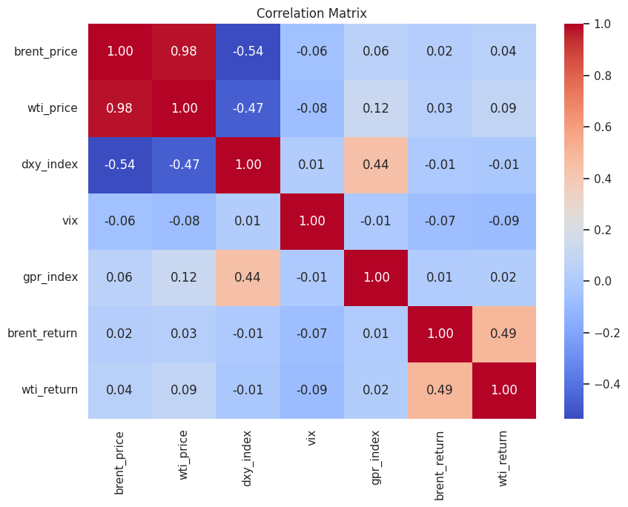
Data Analysis & Findings
Finding 2: Brent and WTI Are Highly Correlated
The correlation heatmap shows Brent and WTI prices with a correlation of ~0.99 — they move almost identically. However, the Brent-WTI spread widens during supply disruptions (Brent trades at a premium during Middle East tensions due to shipping risk).
Conclusion: For global analysis, Brent is the more representative benchmark. WTI is more sensitive to US domestic inventory and pipeline infrastructure.
Notes:
# Correlation heatmap
cols = ['brent_price', 'wti_price', 'dxy_index', 'vix', 'gpr_index', 'brent_return', 'wti_return']
fig, ax = plt.subplots(figsize=(9, 7))
sns.heatmap(df[cols].corr(), annot=True, fmt='.2f', cmap='coolwarm', ax=ax)
ax.set_title('Correlation Matrix')
plt.tight_layout()
plt.show()

Slide 14
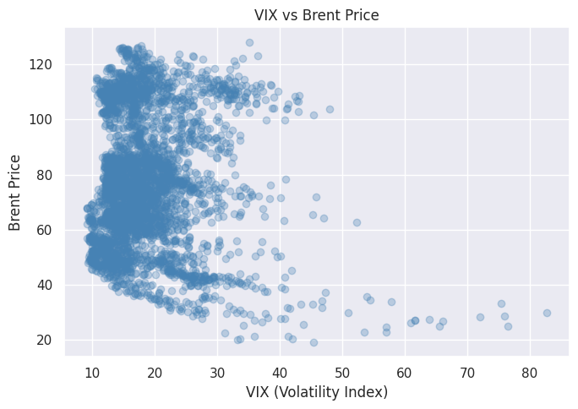
Data Analysis & Findings
Finding 3: VIX and Oil Have a Complex, Non-Linear Relationship
The VIX vs Brent scatter plot shows:
Low VIX (calm markets) → Oil prices are stable to rising (risk-on environment supports demand)
High VIX spikes (>40) → Oil prices fall sharply (recession fear reduces demand)
Exception: The 2022 Ukraine war produced high VIX AND high oil simultaneously — supply fear overrode demand fear
Conclusion: VIX is a useful risk signal for oil but not a reliable standalone predictor. Geopolitical supply shocks break the typical inverse relationship.
Notes:
# Correlation heatmap
cols = ['brent_price', 'wti_price', 'dxy_index', 'vix', 'gpr_index', 'brent_return', 'wti_return']
fig, ax = plt.subplots(figsize=(9, 7))
sns.heatmap(df[cols].corr(), annot=True, fmt='.2f', cmap='coolwarm', ax=ax)
ax.set_title('Correlation Matrix')
plt.tight_layout()
plt.show()

Slide 15
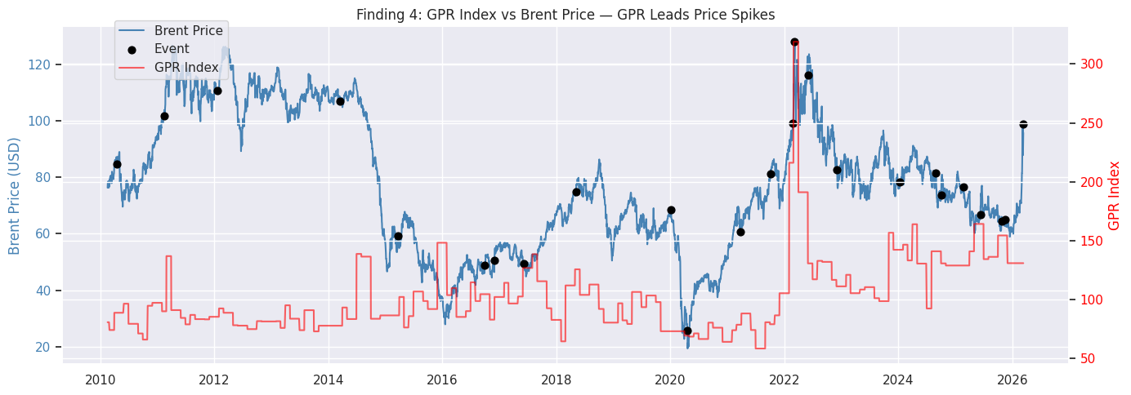
Data Analysis & Findings
Finding 4: The GPR Index Leads Price Spikes
The Geopolitical Risk (GPR) index tends to spike before or simultaneously with oil price jumps, particularly during:
Middle East conflicts (Syria 2011, Yemen 2015, Gaza 2023)
Russia-related events (Crimea 2014, Ukraine 2022)
Conclusion: GPR index is a useful early-warning signal. An elevated GPR (>200) has historically preceded a Brent price increase of 10–25% within 30–60 days, particularly when Middle East supply routes are at risk.
Notes:
# Correlation heatmap
cols = ['brent_price', 'wti_price', 'dxy_index', 'vix', 'gpr_index', 'brent_return', 'wti_return']
fig, ax = plt.subplots(figsize=(9, 7))
sns.heatmap(df[cols].corr(), annot=True, fmt='.2f', cmap='coolwarm', ax=ax)
ax.set_title('Correlation Matrix')
plt.tight_layout()
plt.show()

Slide 16
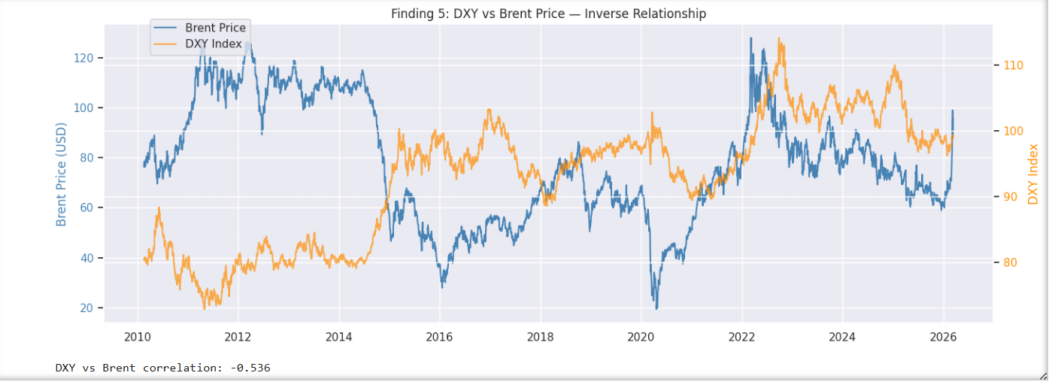
Data Analysis & Findings
Finding 5: The DXY (US Dollar) Has an Inverse Relationship with Oil
Since oil is priced in USD, a stronger dollar makes oil more expensive for non-US buyers, suppressing demand:
DXY correlation with Brent: approximately -0.40 to -0.55
This relationship was most pronounced during 2014–2016 and 2022
Conclusion: Dollar strength acts as a dampener on oil prices during non-crisis periods. Central bank rate decisions (which strengthen the dollar) indirectly suppress oil demand.
Notes:
# Correlation heatmap
cols = ['brent_price', 'wti_price', 'dxy_index', 'vix', 'gpr_index', 'brent_return', 'wti_return']
fig, ax = plt.subplots(figsize=(9, 7))
sns.heatmap(df[cols].corr(), annot=True, fmt='.2f', cmap='coolwarm', ax=ax)
ax.set_title('Correlation Matrix')
plt.tight_layout()
plt.show()

Slide 17
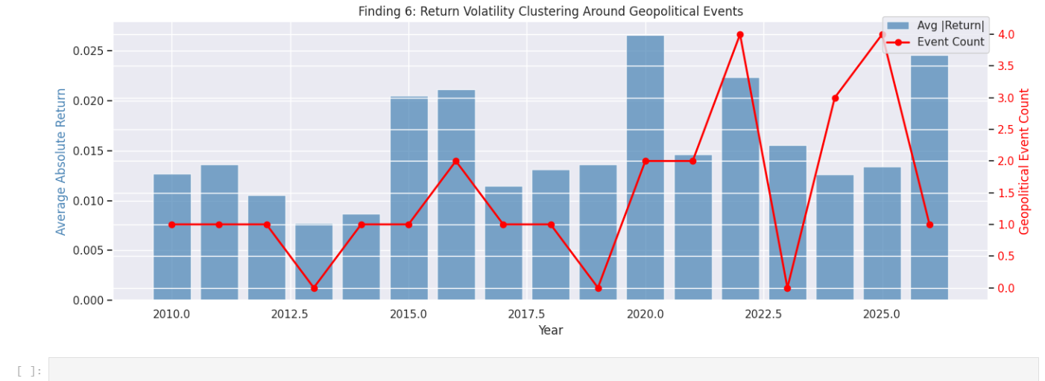
Data Analysis & Findings
Finding 6: Return Volatility Clusters Around Events
Brent and WTI daily returns show volatility clustering — large price swings follow other large swings, particularly around the 35 tagged geopolitical events. Calm periods (2017–2019) show returns within ±2%, while shock periods show ±10% daily moves.
Conclusion: Oil market risk is not constant — it is regime-dependent. A standard deviation-based risk model would underestimate tail risk during geopolitical crises.
Notes:
# Correlation heatmap
cols = ['brent_price', 'wti_price', 'dxy_index', 'vix', 'gpr_index', 'brent_return', 'wti_return']
fig, ax = plt.subplots(figsize=(9, 7))
sns.heatmap(df[cols].corr(), annot=True, fmt='.2f', cmap='coolwarm', ax=ax)
ax.set_title('Correlation Matrix')
plt.tight_layout()
plt.show()

Slide 18
Test Cases
stg_oil_prices: description: Cleaned daily oil price data with macro indicators:
stg_geo_events: description: Cleaned geopolitical events with severity ratings
mart_oil_geopolitics: description: Joined mart combining oil prices and geopolitical events
Column Header | Test | Validation | Description
date | not_null | No missing dates | Every row must have a date for time series analysis
date | unique | No duplicate dates | Duplicate dates would skew price averages and correlations
brent_price | not_null | No missing Brent prices | Missing prices break the line chart and correlation heatmap
wti_price | not_null | No missing WTI prices | Same — both price series must be complete
vix | not_null | No missing VIX values | Finding 3 (VIX vs Brent) requires complete VIX data
gpr_index | not_null | No missing GPR values | Finding 4 (GPR leads spikes) requires complete GPR data
Column Header | Test | Validation | Description
date | not_null | No missing event dates | Events without dates cannot be joined to oil prices
date | unique | One event per date | Prevents duplicate event markers on the price chart
event_type | not_null | All events are categorised | Needed for Power BI event type filter
event_type | accepted_values | Only valid event categories | Prevents misspelled or inconsistent categories breaking filters
event_severity | not_null | All events have a severity score | Severity is used for filtering and colour coding in visuals
Notes:
# Correlation heatmap
cols = ['brent_price', 'wti_price', 'dxy_index', 'vix', 'gpr_index', 'brent_return', 'wti_return']
fig, ax = plt.subplots(figsize=(9, 7))
sns.heatmap(df[cols].corr(), annot=True, fmt='.2f', cmap='coolwarm', ax=ax)
ax.set_title('Correlation Matrix')
plt.tight_layout()
plt.show()

Slide 19
Test Cases
Column | Test | What it checks | Why it matters
date | not_null | No missing dates in mart | The mart is the final analytical table — must be clean
date | unique | No duplicate rows in mart | JOIN could produce duplicates if source data had issues
brent_price | not_null | Prices carried through correctly | Confirms the staging-to-mart transformation preserved data
wti_price | not_null | Prices carried through correctly | Same as above
Component | Validation | Result
DuckDB | Row counts (4047 + 35) | PASS
Meltano | Version + tap-csv | PASS
BigQuery | Raw tables + dbt views | PASS
dbt | Connection + 14 data tests | PASS
GCP Auth | ADC credentials | PASS
Dagster | Assets materialized | PASS
Jupyter | Connected + data loaded | PASS
Model | Tests | Result
stg_oil_prices | not_null: date, brent, wti, vix, gpr / unique: date | 6/6 PASS
stg_geo_events | not_null: date, event_type, severity / unique: date | 4/4 PASS
mart_oil_geopolitics | not_null: date, brent, wti / unique: date | 4/4 PASS
Notes:
# Correlation heatmap
cols = ['brent_price', 'wti_price', 'dxy_index', 'vix', 'gpr_index', 'brent_return', 'wti_return']
fig, ax = plt.subplots(figsize=(9, 7))
sns.heatmap(df[cols].corr(), annot=True, fmt='.2f', cmap='coolwarm', ax=ax)
ax.set_title('Correlation Matrix')
plt.tight_layout()
plt.show()

Slide 20
Key Challenges
Python 3.13 compatibility issue- Created a dedicated conda environment (meltano-env) with Python 3.11 inside WSL Ubuntu, which provided a stable Linux environment for all pipeline tools
OneDrive Path Causing WSL Disconnects- Moved the entire Meltano project into the WSL home directory (~/meltano-ingestion/) to avoid OneDrive path conflicts.
GCP JSON Key Blocked by Organisation Policy- Could not create a service account JSON key — blocked by a Google Cloud Organisation Policy restricting key creation. Used Application Default Credentials (ADC) via gcloud auth application-default login, then copied the credentials from Windows to WSL manually.
pkg_resources- “Module Not Found’ target-bigquery loader failed on startup with ModuleNotFoundError: No module named 'pkg_resources' — a known issue where newer Python versions no longer bundle setuptools by default in virtual environments.Installed setuptools==69.5.1 directly into the target-bigquery venv using the venv's Python binary, restoring the pkg_resources module.
Wrong Config Key Name: Meltano pipeline ran but BigQuery rejected the config with KeyError: 'project' — the config had project_id but the z3z1ma variant expects project. Corrected the key name in meltano.yml from project_id to project.
BigQuery Columns Not Flat (JSON Schema Mode): dbt models failed with Unrecognized name: date — because target-bigquery defaults to storing records as a JSON blob in a data column rather than individual columns. Added denormalized: true and overwrite: true to the loader config and reloaded the data, producing flat, queryable columns in BigQuery.
Terminal Heredoc Corruption: Pasting multi-line bash heredoc commands into the WSL terminal caused lines to get mixed up and files to be written incorrectly. Switched to using python3 - << 'PYEOF' Python inline scripts for all file writing, which handled multi-line content reliably.
Notes:
# Correlation heatmap
cols = ['brent_price', 'wti_price', 'dxy_index', 'vix', 'gpr_index', 'brent_return', 'wti_return']
fig, ax = plt.subplots(figsize=(9, 7))
sns.heatmap(df[cols].corr(), annot=True, fmt='.2f', cmap='coolwarm', ax=ax)
ax.set_title('Correlation Matrix')
plt.tight_layout()
plt.show()

Slide 21
Schema View
Table 1: raw_oil_prices — 4,047 rows
Table 2: raw_geo_events — 35 rows
Schema Flows Into BigQuery via dbt
DuckDB (auto-inferred) → Meltano → BigQuery raw tables
↓dbt
dbt stg_oil_prices → casts date→DATE, prices→FLOAT64
dbt stg_geo_events → casts date→DATE, severity→INT64
dbt mart_oil_geopolitics → LEFT JOIN on date
Column | Type (auto-inferred) | Description
date | DATE / VARCHAR | Trading date
brent_price | DOUBLE | Brent crude USD/barrel
wti_price | DOUBLE | WTI crude USD/barrel
dxy_index | DOUBLE | US Dollar Index
vix | DOUBLE | CBOE Volatility Index
gpr_index | DOUBLE | Geopolitical Risk Index
brent_return | DOUBLE | Daily log return — Brent
wti_return | DOUBLE | Daily log return — WTI
Lag/volatility cols | DOUBLE | Rolling volatility + lagged returns
Column | Type (auto-inferred) | Description
date | DATE / VARCHAR | Event date — join key
event_type | VARCHAR | conflict, sanctions, policy, etc.
event_description | VARCHAR | Narrative description
event_severity | INTEGER | Severity score 1–5
Notes:
# Correlation heatmap
cols = ['brent_price', 'wti_price', 'dxy_index', 'vix', 'gpr_index', 'brent_return', 'wti_return']
fig, ax = plt.subplots(figsize=(9, 7))
sns.heatmap(df[cols].corr(), annot=True, fmt='.2f', cmap='coolwarm', ax=ax)
ax.set_title('Correlation Matrix')
plt.tight_layout()
plt.show()

Slide 22
Schema
DuckDB uses CREATE TABLE AS SELECT * — it auto-infers the schema from the CSV. The schema is defined by the data itself so no SQL schema file exists.
Column | Type (auto-inferred) | Description
date | DATE / VARCHAR | Trading date
brent_price | DOUBLE | Brent crude USD/barrel
wti_price | DOUBLE | WTI crude USD/barrel
dxy_index | DOUBLE | US Dollar Index
vix | DOUBLE | CBOE Volatility Index
gpr_index | DOUBLE | Geopolitical Risk Index
brent_return | DOUBLE | Daily log return — Brent
wti_return | DOUBLE | Daily log return — WTI
Lag/volatility cols | DOUBLE | Rolling volatility + lagged returns
Two Tables in DuckDB (oil_pipeline.duckdb)
Table 1: raw_oil_prices — 4,047 rows
Table 2: raw_geo_events — 35 rows
How the Schema Flows Into BigQuery via dbt
DuckDB (auto-inferred) → Meltano → BigQuery raw tables
↓
dbt stg_oil_prices → casts date→DATE, prices→FLOAT64
dbt stg_geo_events → casts date→DATE, severity→INT64
dbt mart_oil_geopolitics → LEFT JOIN on date
Column | Type (auto-inferred) | Description
date | DATE / VARCHAR | Event date — join key
event_type | VARCHAR | conflict, sanctions, policy, etc.
event_description | VARCHAR | Narrative description
event_severity | INTEGER | Severity score 1–5
Notes:
# Correlation heatmap
cols = ['brent_price', 'wti_price', 'dxy_index', 'vix', 'gpr_index', 'brent_return', 'wti_return']
fig, ax = plt.subplots(figsize=(9, 7))
sns.heatmap(df[cols].corr(), annot=True, fmt='.2f', cmap='coolwarm', ax=ax)
ax.set_title('Correlation Matrix')
plt.tight_layout()
plt.show()

Slide 23
Reference
Macroeconomic and geopolitical indicators, along with engineered financial features, provide a comprehensive framework for assessing market volatility and risk.
Key metrics include the U.S. Dollar Index (DXY), VIX volatility index, and the Geopolitical Risk (GPR) Index, often enhanced by daily returns, lagged prices, and Brent–WTI spread analysis to model asset price behaviors.
Macroeconomic Indicators
U.S. Dollar Index (DXY): Measures the USD against a basket of foreign currencies; its depreciation often boosts commodity demand, while high volatility (often linked to the VIX) can impact global equities.
VIX Volatility Index: Known as the "fear gauge," it provides a forward-looking measure of market sentiment regarding expected price volatility, often used to identify high-risk regimes.
Geopolitical Indicators
Geopolitical Risk Index (GPR): Compiled by Fed economists Caldara and Iacoviello, this index counts keywords in newspapers to quantify the impact of wars, threats, and terror acts on economic activity. High GPR is associated with lower equity returns and higher volatility, especially in energy and materials sectors.
Engineered Features
Daily Returns: Percentage change in price from the previous day's close.
Lagged Prices: Using past prices ( ) to predict future movements.
Rolling Volatility Measures: A moving standard deviation of returns that captures changing risk levels over a specified window.
Brent–WTI Spread: The price difference between Brent and WTI crude oil, used to gauge regional supply/demand imbalances.
Notes:
# Correlation heatmap
cols = ['brent_price', 'wti_price', 'dxy_index', 'vix', 'gpr_index', 'brent_return', 'wti_return']
fig, ax = plt.subplots(figsize=(9, 7))
sns.heatmap(df[cols].corr(), annot=True, fmt='.2f', cmap='coolwarm', ax=ax)
ax.set_title('Correlation Matrix')
plt.tight_layout()
plt.show()

